Slide 1
PSF-R = PSF Reconstruction
the call for a blind PSF recovery
Carmelo Arcidiacono
Osservatorio Astronomico di Padova

Slide 2
Abstract
The thirst for enhanced sensitivity brought to extremely sophisticated systems. The current paradigm for optical instrumentation is to design larger and larger telescopes properly armed with Adaptive Optics (AO) modules. Such effort caused an analogous complexity of the camera/spectrograph response. The ground-based PSF, which was seeing dependant, now is time-evolving and spatially varying on minutes and arcsecond scales, respectively. The stochastic behaviour of both the optical turbulence and the telescope vibrations corresponds to an unreliable PSF definition. A long time average may reduce the divergence with respect to predictions, reducing the problem to an accurate knowledge of the initial conditions. Accurate photometry and morphological studies require accurate PSF knowledge. The PSF information is mandatory, but the availability of point sources is not obvious since the field of view is typically small (tens of arcsec).
Today, I focus on the blind PSF-reconstruction. “Blind” because applies to the cases when the PSF reference is not available: when the only viable way to build a PSF is to use complementary information made available by the observatory (seeing, wind speed) or by the AO instrument. These “telemetry” data offer the opportunity to reduce the PSF object to parameters describing turbulence statistics, AO loop, noise, vibrations and the optical train. I describe a possible method, in developing using the SOUL@LBT + LUCI imager couple as a reference application.

Slide 3
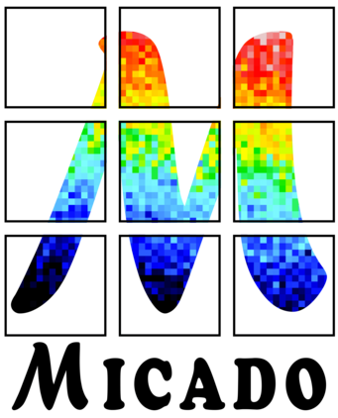
Context
I collaborate to the development of MAORY and MICADO adaptive optics module and camera for the European ELT.
This talk recaps the development of a novel algorithm for the PSF Reconstruction, currently using the SOUL @ LBT data as test case, and serving as testbench for the MICADO PSF-R.
This activity has place within the MAST&R working group, and gathered contributions from INAF Arcetri (SOUL data) and INAF Padova (MICADO PSF-R team).

Slide 4
Math, ASTronomy and Research (MAST&R)
MAST&R is an INAF group clustering activities on mathematical methods for high-resolution imaging
It supports several mainstream adaptive optics (AO) projects as MAORY, MICADO, ERIS, SHARK, MAVIS
Focus on PSF- Reconstruction
Looking for constructive return for other large projects as Gaia and Euclid

Slide 5
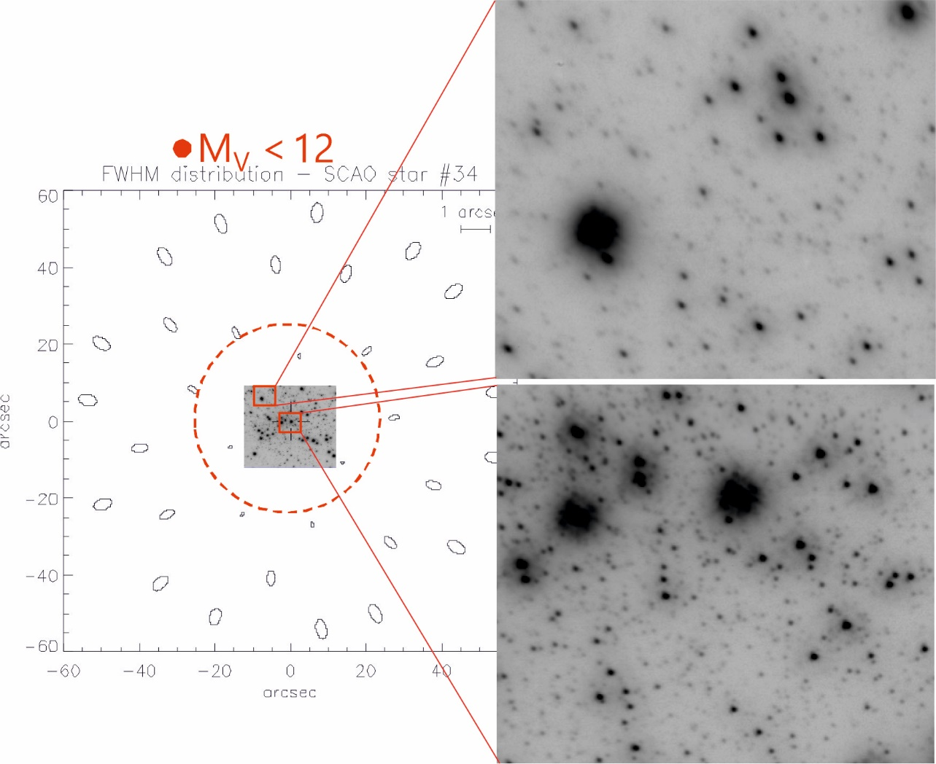
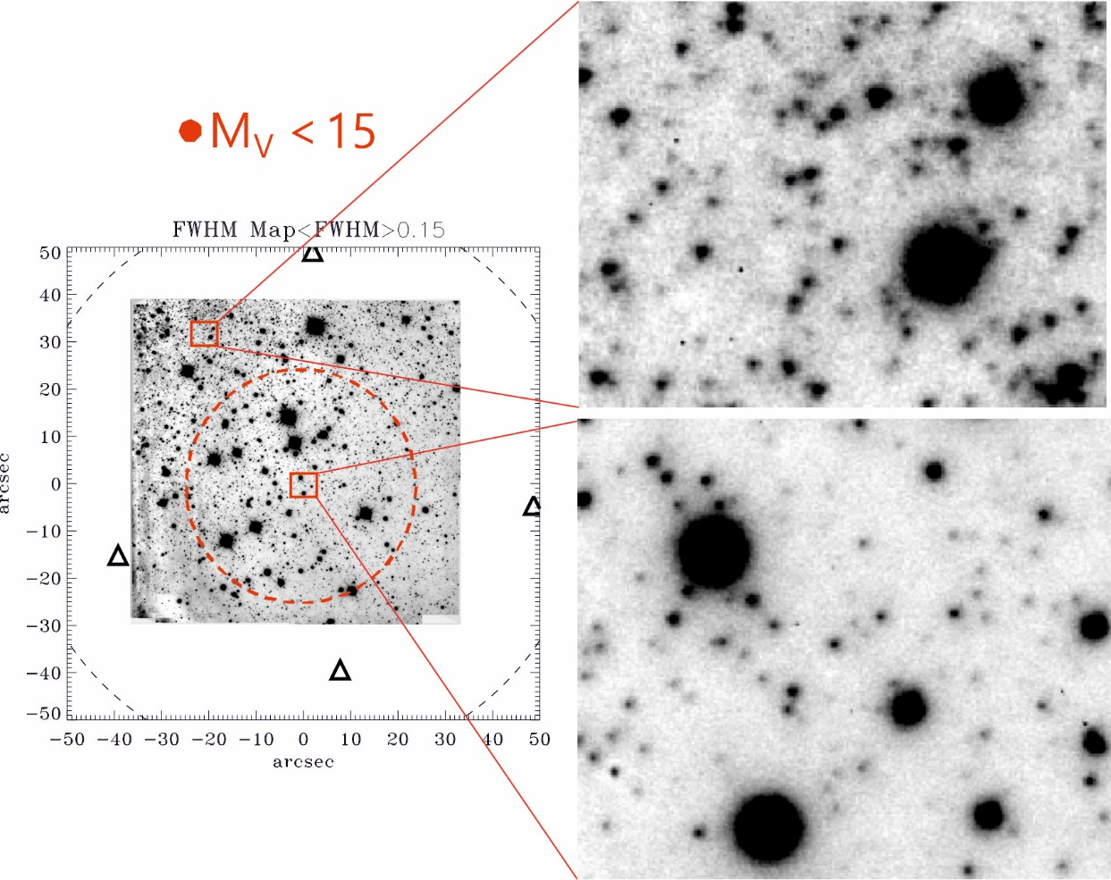
Today we focus on the SCAO PSF toward the reference star.
SCAO
MCAO
A Single Conjugate Adaptive Optics modules senses and corrects the turbulence in the direction of the single guide star.
*M15 core, 23’’x23’’ data J band
PISCES+FLAO @ LBT, inset 6 ’’x5’’
*NGC 6388 halo,65’’x63’’, Ks band, MAD @ VLT, inset 6 ’’x5’’

Slide 6
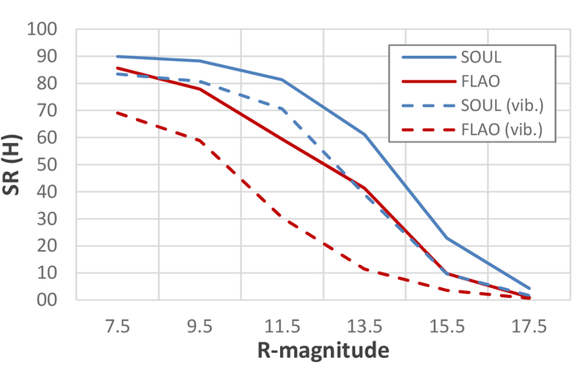
SOUL
SOUL upgraded the FLAO systems at the LBT replacing the wavefront sensor camera with an OCAM2k.
The FLAO and SOUL are SCAO adaptive optics modules.
SOUL improves several merit figures: sky coverage, magnitude limits, SR values.
FLAO and SOUL feed the NIR camera LUCI.

Slide 7
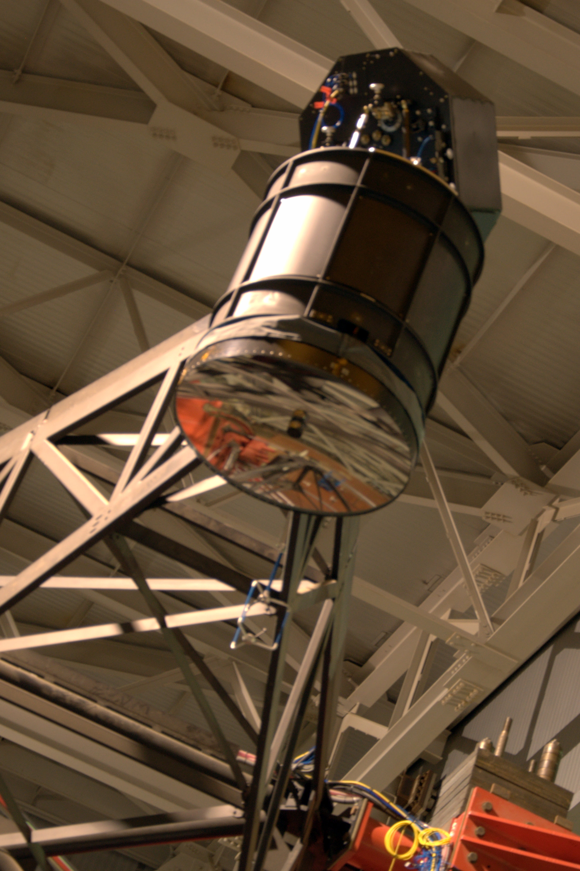
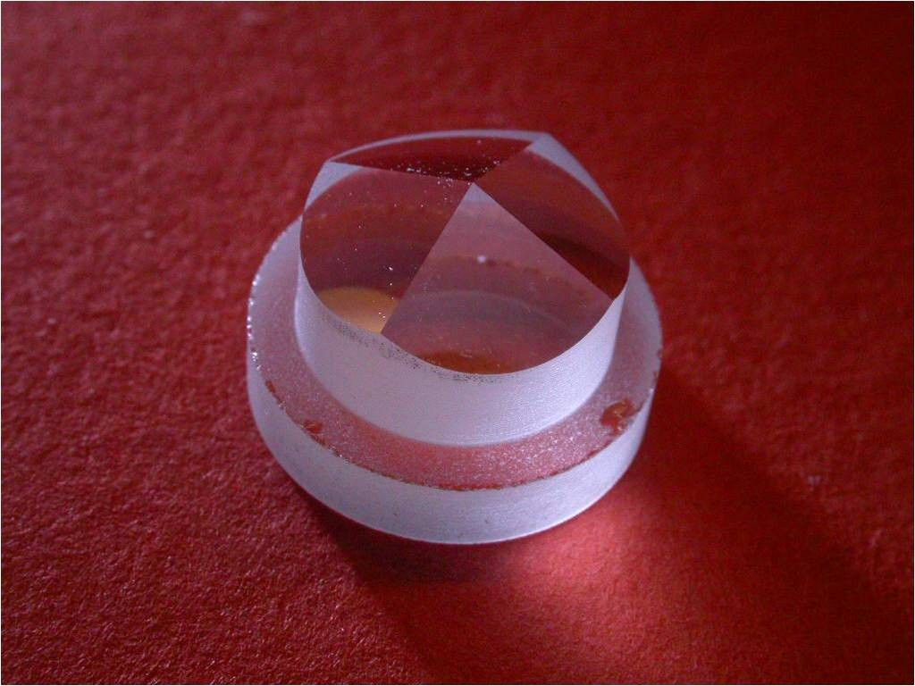
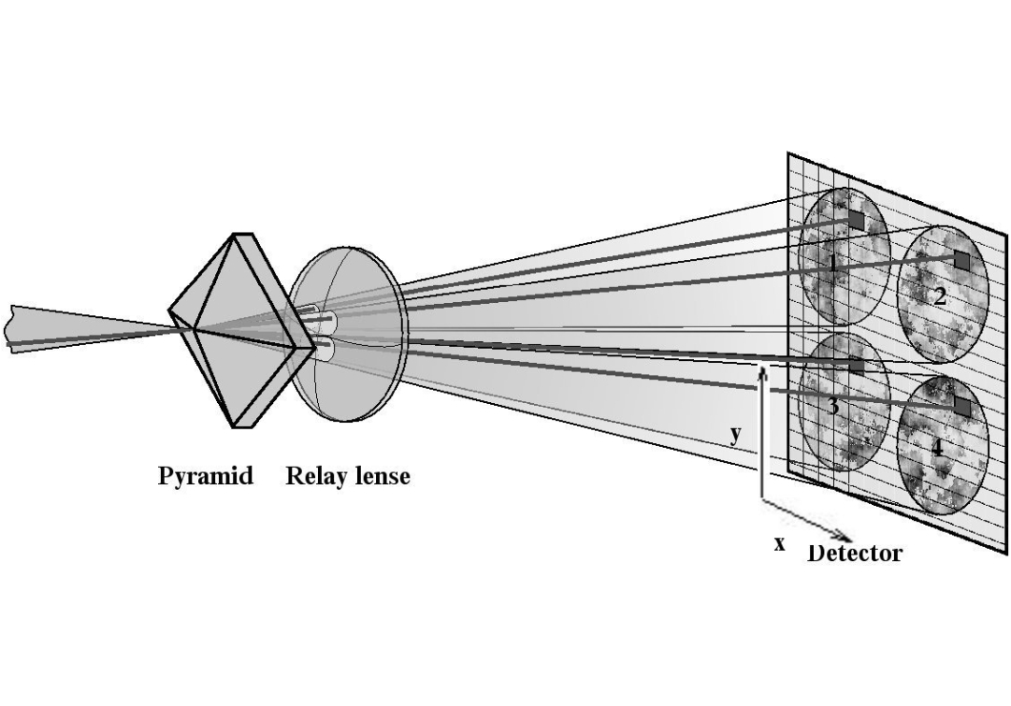
SOUL and MICADO PSF-R
MICADO is one of the first light instrument of the ELT. It will be fed by ELT through the MAORY adaptive optics for MCAO or by an internal SCAO module.
The INAF contribution to MICADO is for the development of the PSF-R software (MICADO specific).
The important connection is that both MICADO SCAO and SOUL modules use:
a pyramid for WaveFront Sensing (Ragazzoni 1996);
correct the turbulence using a contactless voice coil deformable mirror controlled in position using capacitive sensors (Salinari, Del Vecchio and Biliotti 1993)
SOUL is the optimal benchmark for the MICADO PSF-R development.
https://sites.google.com/inaf.it/micado-italy/

Slide 8
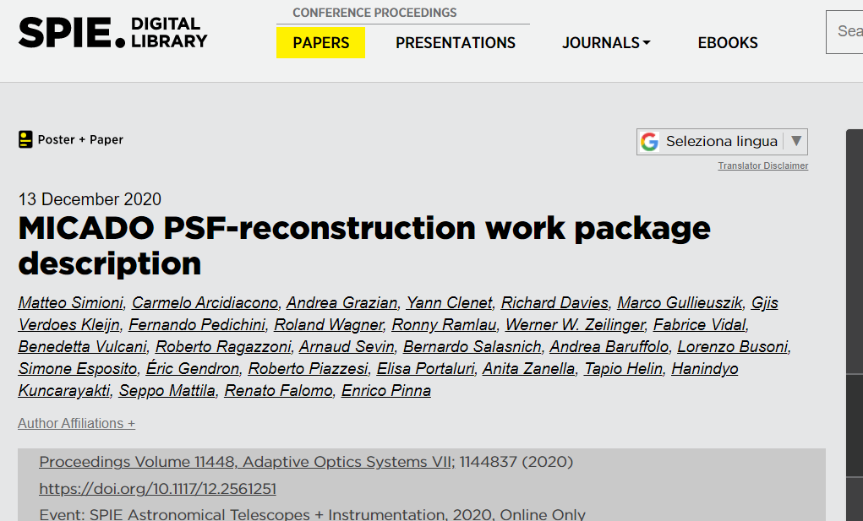
For more information about MICADO PSF-R
Simioni et al 2020
https://doi.org/10.1117/12.2561251

Slide 9
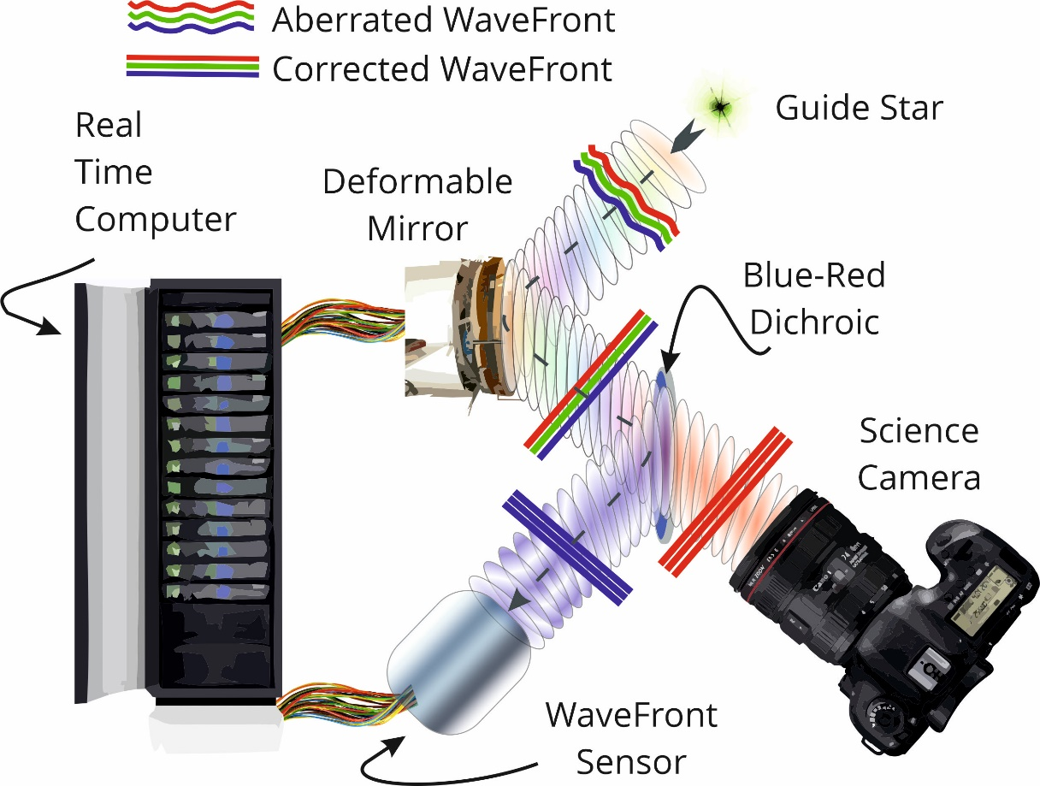
Focusing on the problem PSF measures performance
SCAO Example: CAMERA AND WFS see the same WF
An AO system squeezes the PSF by moving one or more deformable mirrors against the fast optical disturbance injected by the turbulence.
The AO performance ultimately depends on the initial seeing and telescope vibrations.
The WF correction is limited by loop frequency, actuators spacing (on the DM), Wave Front Sensor-errors and by the control of the Non-Common Path Aberration (NCPA).

Slide 10
PSF formation and AO effects
$\iint{dtdλ}$ of the instant PSF
AO flattens the incoming WF and acts moving speckles from the seeing halo to the Airy diffraction pattern
Example: 20 sec, 0.9’’ seeing in V,
X bar: SR Ratio
Y bar: EE in the diffraction limited core
Closing Loop
Sequence

Slide 11
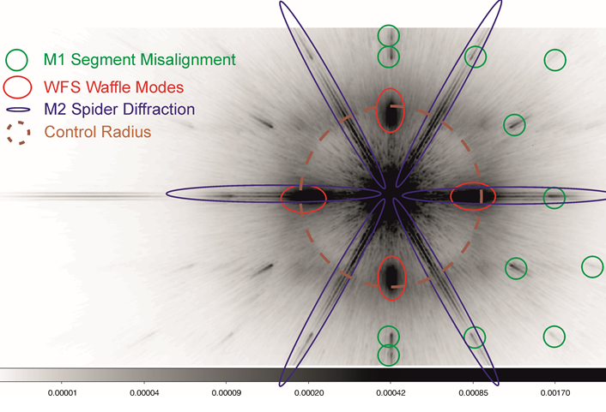
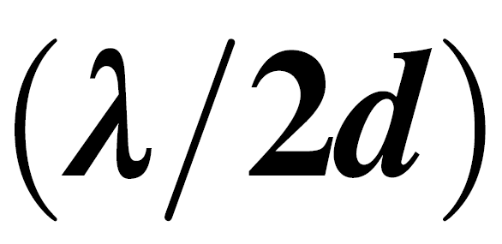
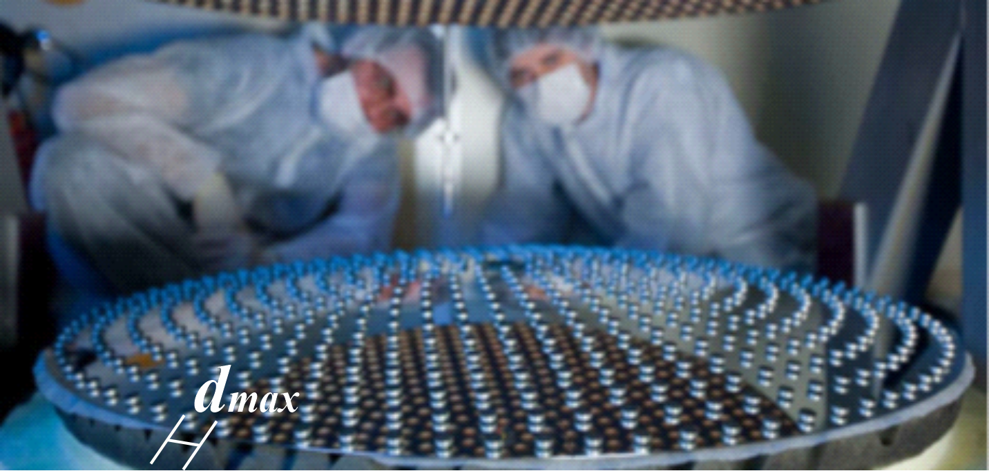
Quasi Diffr.-Lim. PSFs have Structures
The number of DM modes used fixes the highest frequency corrected
It is ultimately limited by the number of actuators
This highest frequency generates the so-called control radius (Perrin+2003), well visible in SCAO mode
Control Radius is at where d, is the dimension characteristic distance between two adjacent actuators. Smaller the distance larger the control radius where the uncorrected seeing starts.
Low spatial freq
High spatial freq
i.e., the c. radius follows the maximum frequency controlled by the AO, accordingly to the mode number, here fixing the rms of the corrected WF.
Waffle: effect of badly seen freq-

Slide 12
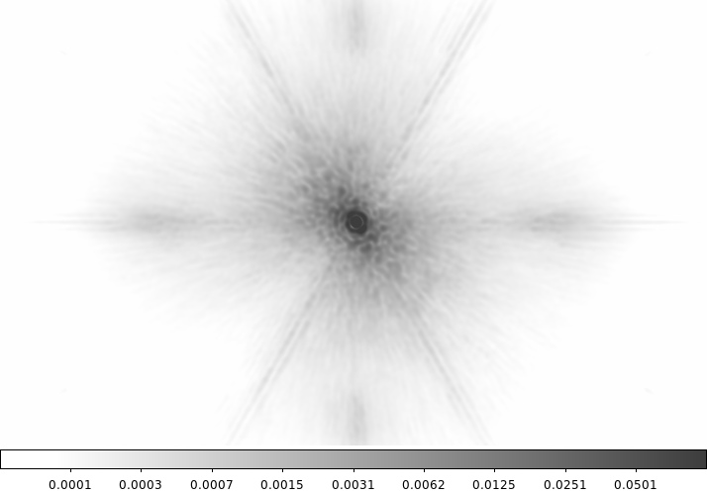
Why this PSF Reconstruction
Spectroscopy
SMALL FoV
Stars Density
We know that AO correction refurbishes the PSF with structure, which components are field and time dependent.
The presence on the observed frames of valid reference stars for PSF calibration is not obvious.
In these cases, a “blind” method for PSF recovery is critical:
The PSF ignorance can lead to significant systematic errors for science data extraction.
The actual PSF is not a priori fully determined, depending on the observing conditions: seeing, wind speed, the brightness of the reference stars, etc.

Slide 13
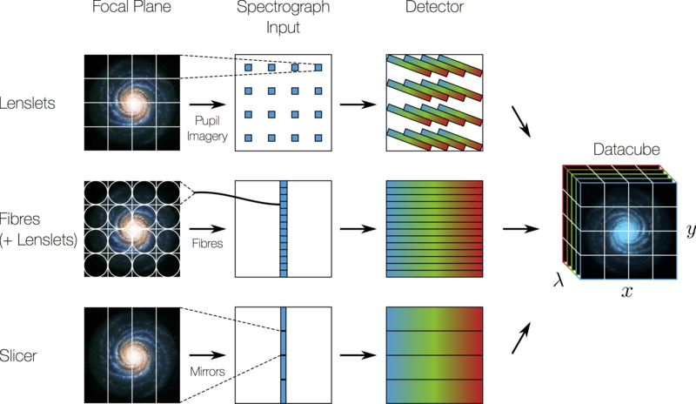
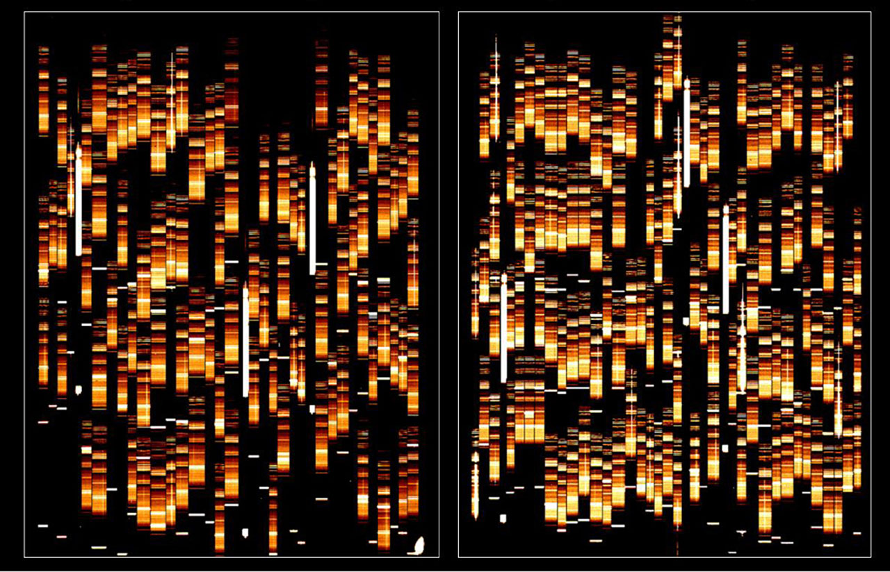
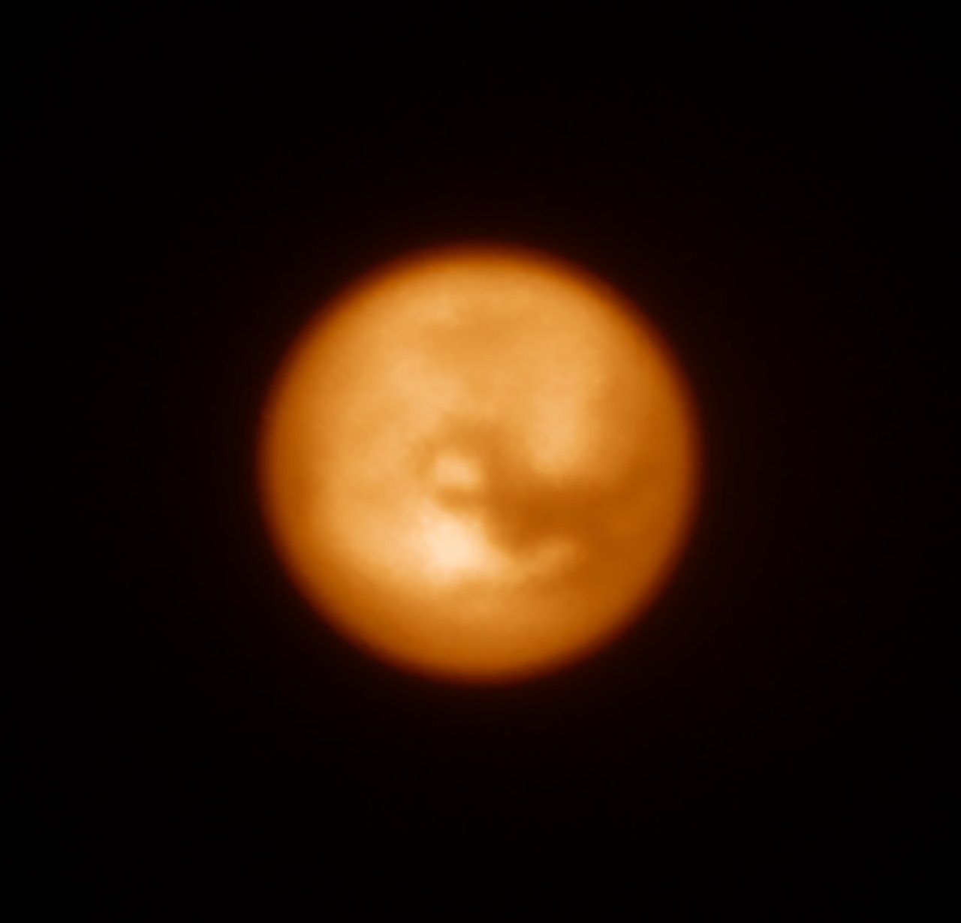
This is a blind PSF Reconstruction
THIS PSF RECONSTRUCTION IS NOT …
It is not PSF-fitting (DAOPHOT, SEXTRACTOR)
It is not Performance Simulation (i.e. PASSATA Agapito)
It is not the hybrid (i.e. PRIME by Beltramo Martin)
Other blind PSF Reconstruction methods:
Wagner et al 2018 (MICADO)
Ragland et al 2018, Jolissant et al 2015 (Keck)
Fusco et al 2020 , 2021 (MUSE-AO)
MOS [non-AO, VIMOS]
Titan, SPHERE AO

Slide 14
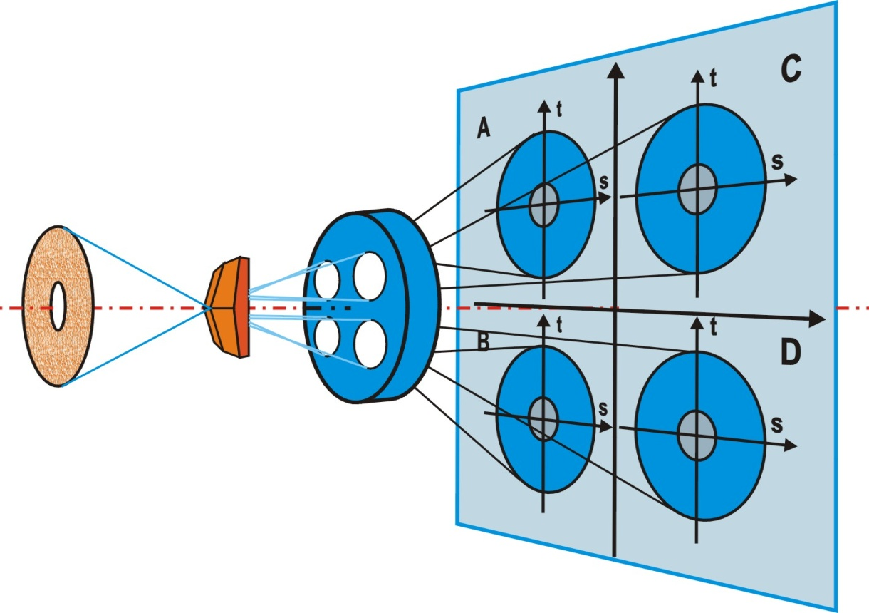
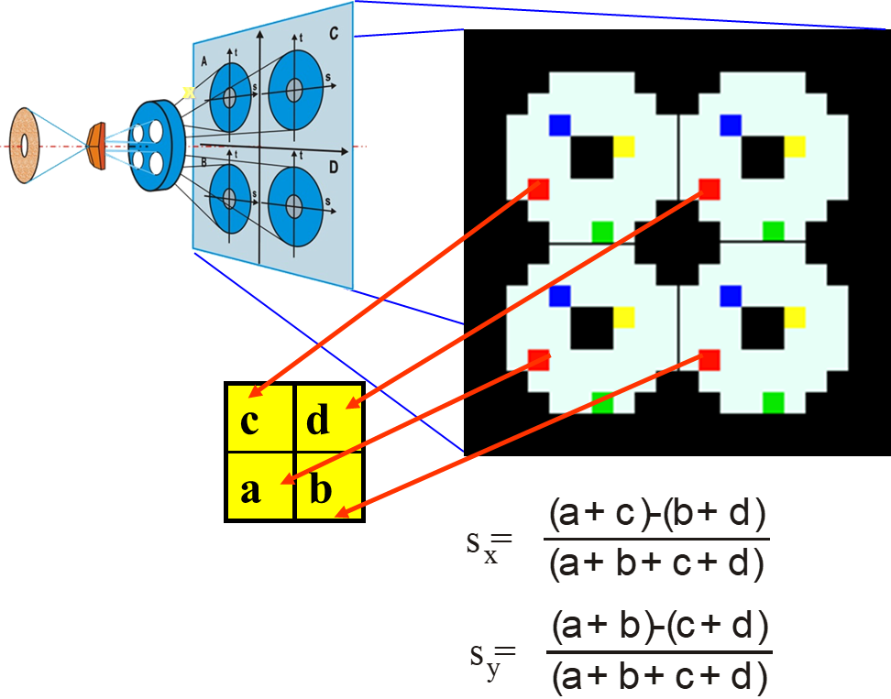
Slopes are the primary output of the WFS: WF first derivative
Focal plane
Telescope
pupil
Pyramid
Objective
4 Pupil images
and CCD plane
a,b,c,d are the local Intensities
For each point on the pupil, the WFS retrieves (x,y) local WF gradient (slopes..)

Slide 15
PSF-R in short
It uses the AO loop information registered simultaneously with the science frame.
It fits turbulence and noise models on the AO data.
It applies instrumental look up table from calibration
It applies corrections for specific observing conditions.
The idea is that each WFS slopes iteration allows computing instantaneous WF, also adding additional contributions.
For each WF we can compute the instantaneous PSF considering the pupil mask.
In the following, I take as reference the case of SOUL at LBT
WFS Slopes
DM commands
Loop Control Gains
Seeing
Noise
Optical Loop Gain
Calibrated NCPA
Control Matrix
IF-measured DM modal base
Interaction Matrix
Airmass
Derotator angle
Parallactic Angle
Filter Width
SCAO Example: CAMERA AND WFS see the same WF

Slide 16
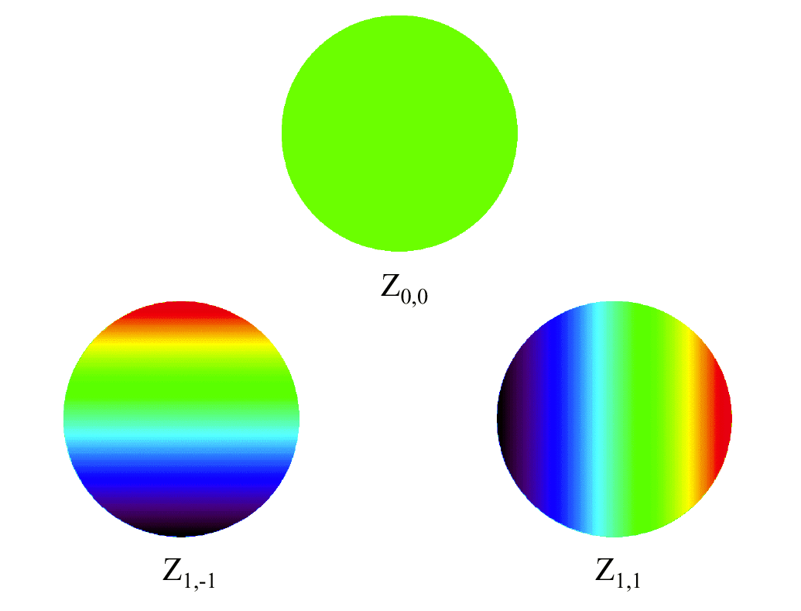
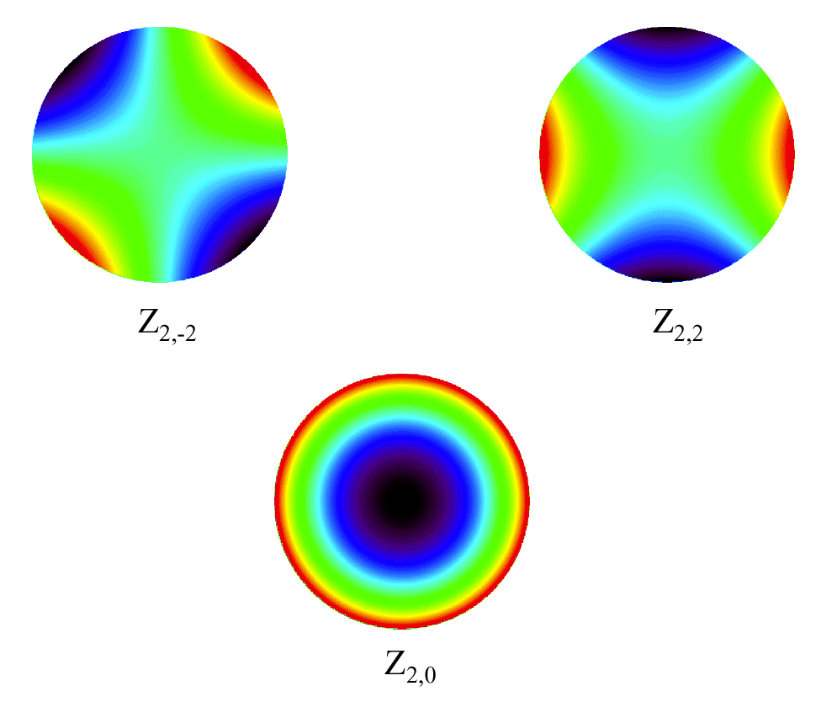
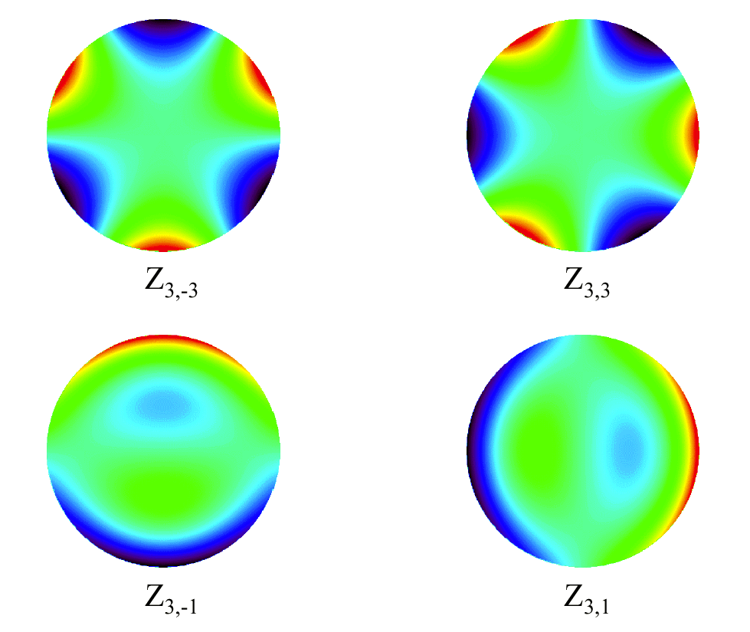
WF modal description
Regardless the origin of the WF residuals, all the WFs we use are described as linear combination of shapes (modes, below). For example, both the instantaneous WF from the slopes or the one corresponding to the DM are expressed through a vector of coefficients.
Similarly, the modal PSD corresponds to the temporal standard deviation of this coefficients.

Slide 17
What are the telemetry data
The PSF-R algorithm requests data synchronous to the observations. This condition allows accounting for specific incident happening during open shutter time (wind gusts, seeing spikes, and una tantum vibrations and loop instabilities).
Better is the coverage of observation, higher is the precision of the reconstructed PSF.
WFS Slopes
The camera-synchronous WFS measurements history: it can be a large data sets since grows at loop frequency. It is large as twice the number of active sub-apertures (measuring point=N_{iter})
The camera-synchronous DM shape history: growing at loop frequency and large as the number of controlled modes M.
The control loop describes the DM shape as linear combinations of the Z_{i} =i^{th}-shapes composing the DM modal description, with coefficients [c_{i}(t) i=1 to 500]: DM(t) = Σ_{i}c_{i,t}Z_{i} = c(t) × Z
The vector of gain long as the number of modes in use, g.
[2N_{sub}x N_{iter}]
DM commands
[N_{modes}x N_{iter}]
Typical descriptions for the modal base are Zernike polynomials or Karhounen Loeve modes.
Loop Control Gains
[N_{modes}]

Slide 18
Useful Previously Calibrated Information
The AO control law that defines the status of the DM through the linear combination coefficients, c(t):
c(t₁) = c(t₀) + g • (slopes × R^{T}-NCPA)
While the actual shape of the DM in terms of phase is obtained moving from the coefficients to the shapes composing the modal base: WF_{DM}(t₁) = c(t₁) × KL
Reconstructed delta WF
R is the control matrix, this is known and determined using the calibrated interaction matrix (IM).
KL is the array containing the WF map of each of the modes in the modal base (Karhounen-Loeve)
NCPA is the vector of coefficients containing the modal description of the WF difference between AO and camera
IM is the DM to WFS interaction matrix, the pseudo-inverse IM⁻¹ will be used by the PSF-R algorithm
Ideally, the instantaneous WaveFront (WF) seen by the WFS is: WF_{SLP} = slopes × IM⁻¹ × KL.
WF_{SLP} is a low-resolution image of the original WF.

Slide 19
Parallel component
The WF_{SLP} = slopes × IM⁻¹ × KL is the so called “parallel part“ responsible for the shape of the PSF within the control radius.
The parallel WF history is then computed from the slopes history.
However, several corrections need to be implemented:
Slopes to WF operation needs non-linearity correction, through the optical loop gain application:
WF_{SLP} = slopes × IM⁻¹ •g_{opt} × KL
The WF part due to the noise contribution is weighted by the loop gain g .. See next
g_{opt} = Optical Loop Gain
== sensitivity

Slide 20
Sensitivity of the pyramid depends on the PSF size on the pyramid pin
D
A
D
A
Total number of
photons=2000
C
B
C
B
C=D slightly higher than A=B
Same movement along
x-axis:
different spot size bring to different slope value.
C=D much higher than A=B
C=D=600ph A=B=400ph
C=D=900ph A=B=100ph
S_{x}=0.2=20%
S_{x}=0.8=80%
The smaller the spot, the more sensitive is the WFS!

Slide 21
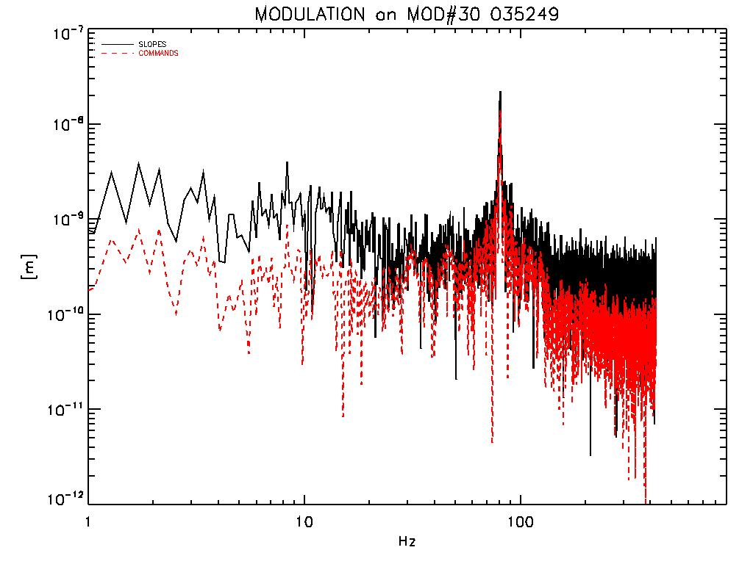
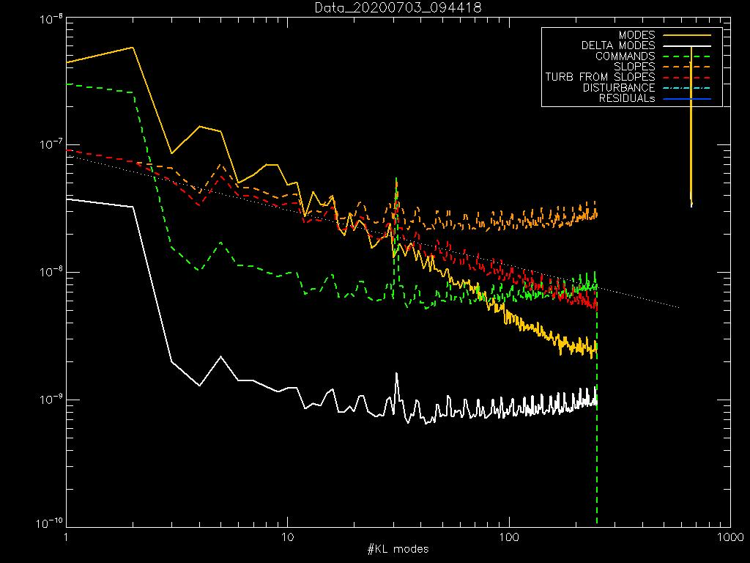
Optical loop gain re-calibration
SOUL continously tracks the optical gain (sensitivity), by measuring the feedback to a sinusoidal modulation injected on mode #30.
The measured slopes are already corrected for this value. HOWEVER…
The g_{opt} is re-computed in the PSF-R post processing using again the peak of temporal power spectrum corresponding to the continous modulation of KL mode #30, and now comparing the ratio between the amplitudes of
modes#30 applied by DM / modes #30 seen by the WFS
with respect to similar ratio on adjacent modes.
g_{opt} = Optical Loop Gain

Slide 22
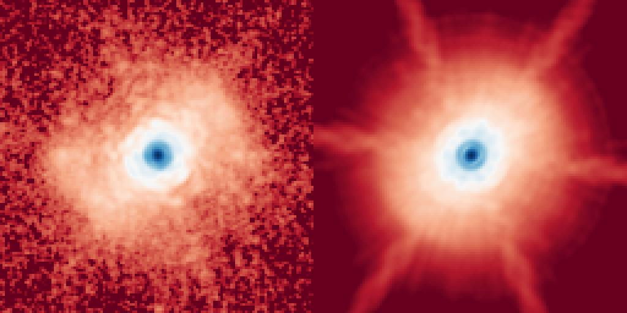
What if the turbulence has parallel components only?
Here LBT SOUL PSF acquired in daytime (laboratory like).
Here LBT SOUL PSF Reconstructed using slopes, only parallel components.
Control radius disappears!
Here the turbulence is injected by the Deformable mirror: the highest frequency 1/2d_{max} limits the region covered by the PSF.
Only the diffraction pattern propagates beyond that limit.

Slide 23
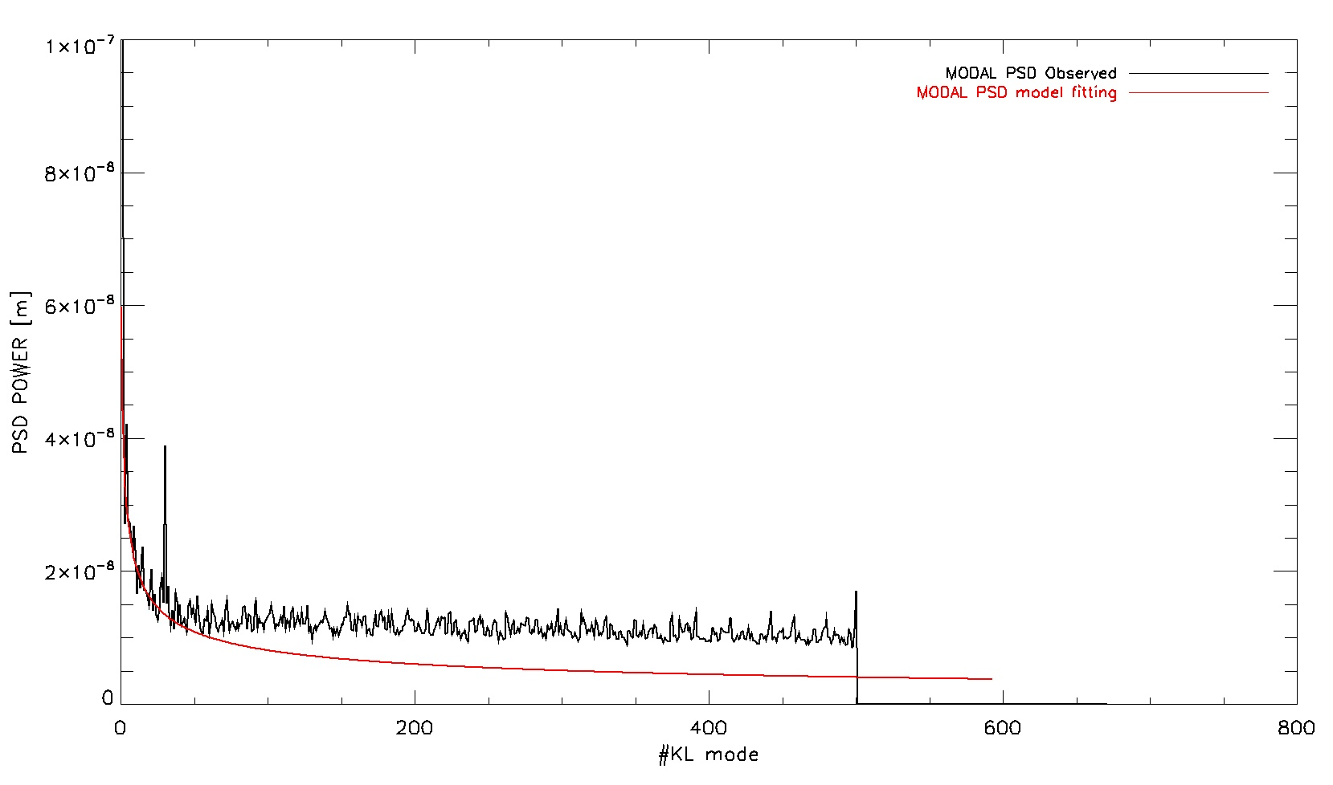
Noise part into the parallel component
From the slopes history we can derive both noise and turbulence contributions.
The noise component is part of the parallel WF. It is added to the estimated WF as part of the WF_{SLP} .
From the slopes the modal coefficient vector, m:
m = slopes × IM⁻¹ •g_{opt} returns the elements of the linear combination of WF shapes composing the instantaneous WF_{SLP} .
The noise part in the m is then multiplied for the loop gain g, and the remaining part is associated to the optical turbulence and transferred as is into the WF_{SLP} .
Noise component is here

Slide 24
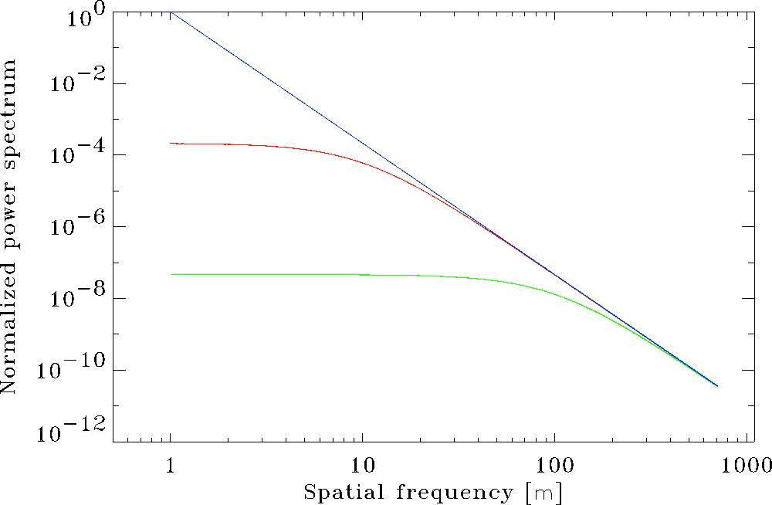
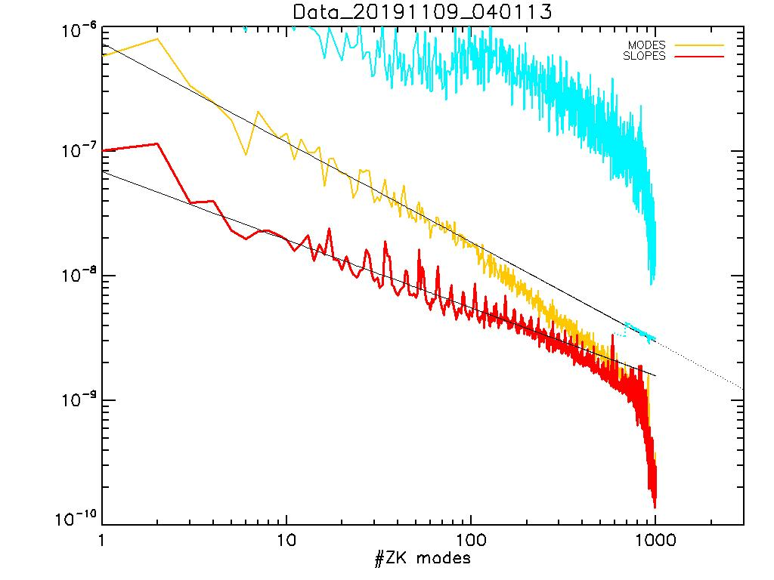
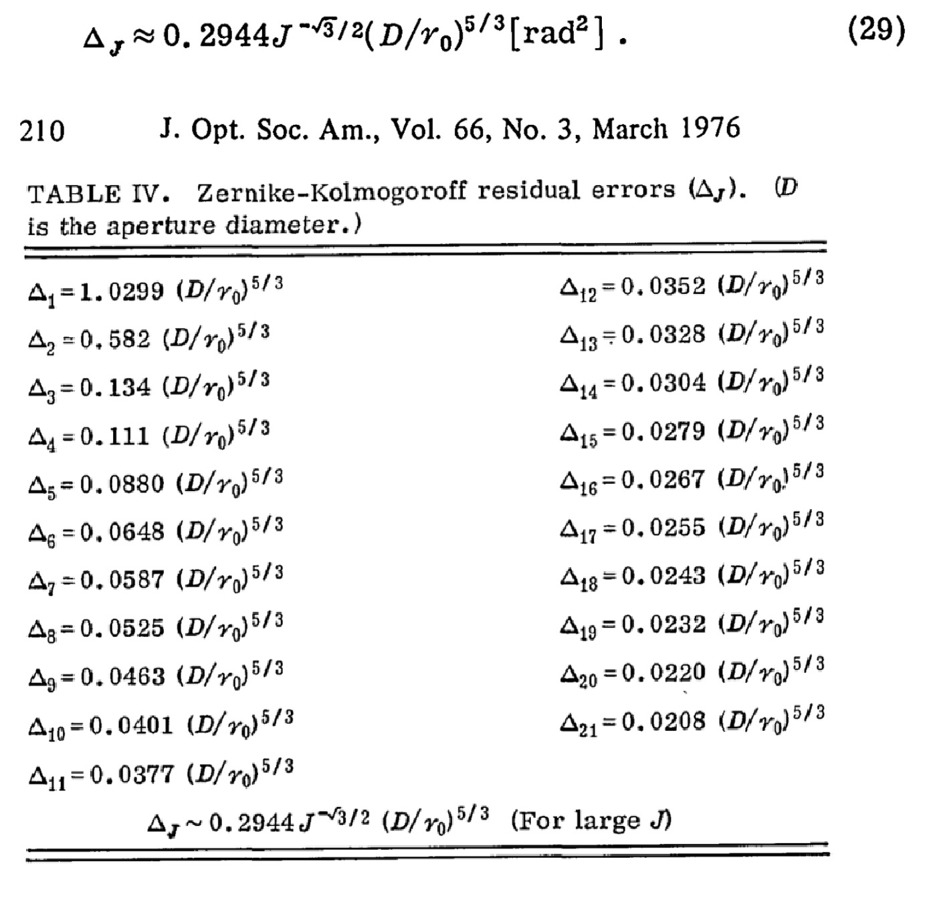
Orthogonal component and derived quantities
The PSF-R algorithm estimates the characteristics length (r₀) of the spatial power spectrum of the turbulence, fitting analytical model onto the DM data.
I used here a modal representation of the power adapting the Noll ’76 formula fitting the power law on the DM modes time history.
The point is to identify in the original atmospheric turbulence contribution.
Already assuming tip tilt dominated by the vibration and excluding these from the fit.
The fit allows computing
the power for the uncontrolled components (modes),
estimating the orthogonal part of the WF.
In SOUL data we had 500 KL modes, the orthogonal components extends up to Zernike 3000.
DM Zernike power

Slide 25
Limitation and development
We use the history of the DM shape for the estimation of the turbulence PSD.
However, this opportunity is less valid in the cases:
a few modes are controlled,
and/or
Correction is poor (DM is not the negative copy of the reference star WF).
In the future, this method should be revised, accepting as reference for the fit the pseudo-open-loop data, possibly noise corrected.
Pseudo-open loop data is the sum of the contributions to the WF given by DM and WFS.

Slide 26
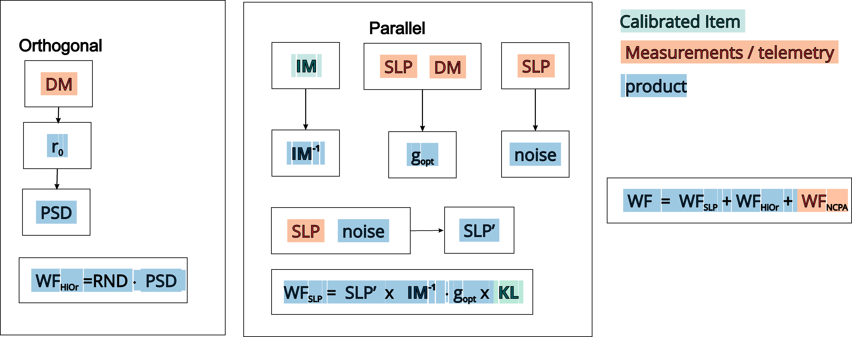
Building the PSF
The integrated PSF is the sum of a number of realizations, one for each slope vector instant
$${WFrad=2∗π∗WF}_{k}/λ+{WF}_{NCPA}$$
PSF = $\sum_{k=1}^{nstep}{|FFT\left(Mask eiWFrad\right)|2}$

Slide 27
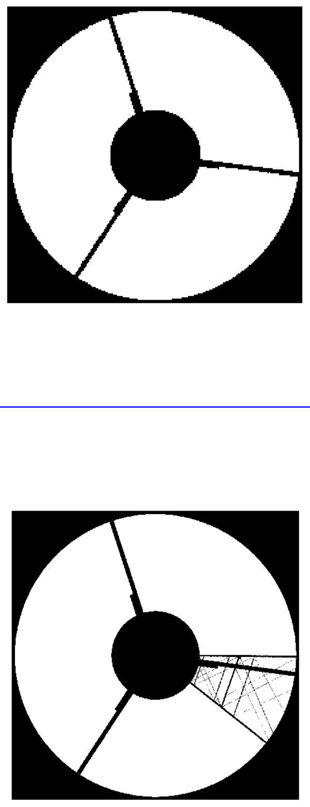
Pupil Masks-Cold stop and Parallactic angle
The aperture mask for SOUL depends on daytime and nighttime pupils are different, because in nighttime LUCI does not see the M2 spider.
Actual size of the telescope is 8.06 meter because of the extended cold stop in LUCI, and central obstruction is 0.314, because of the reflective design of the N30 camera.
Daytime pattern does not rotate, M2-M3 spider arms rotate with the parallactic angle
We need to rotate the spider pattern in the mask, to match the parallactic angle clocking.
Daytime Static
Static+Rotating

Slide 28
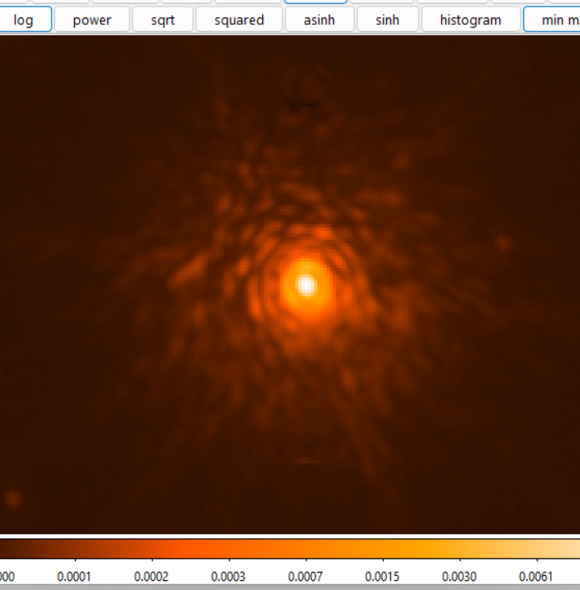
Final rendering
Last step for the PSF-R is the application of correction on the computed integrated PSF.
The PSF resulting from previous steps are monochromatic. The filter profile is then applied, considering slight changes of the PSF moving across the wavelengths in the filter.
Chromatic dispersion w.r.t. airmass is also considered.
Chromatic dispersion
Ks band 20deg elev.

Slide 29
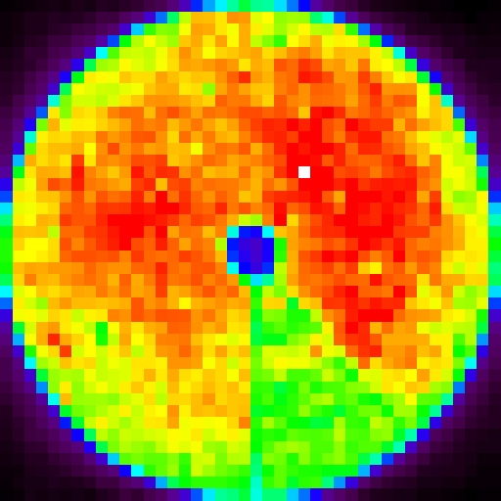
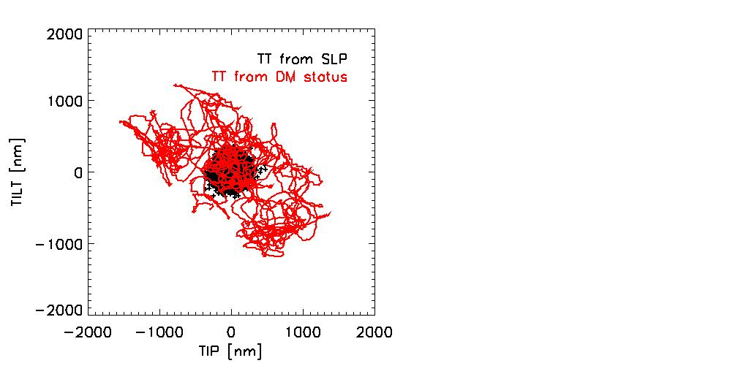
Other quantities that can be retrieved

Slide 30
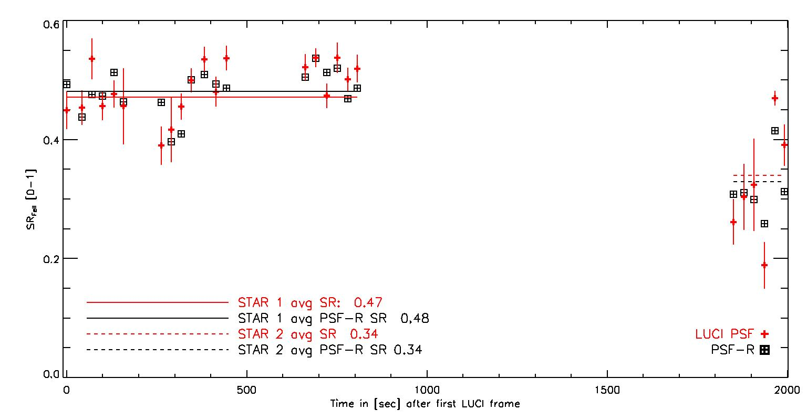
Application to SOUL data
25 LUCI observationa, each one simultaneously registered with WFS telemetry on the LBT left side, two different targets, with similar magnitudes.
STAR 1, mag 9.7, pretty stable, average SR=48, SR dispersion 3.5 point of % of SR (0.035)
STAR 2
STAR 1
STAR 2, mag 10.0, pretty unstable, average SR=34%, SR dispersion 5.9 point of % of SR (0.059).

Slide 31
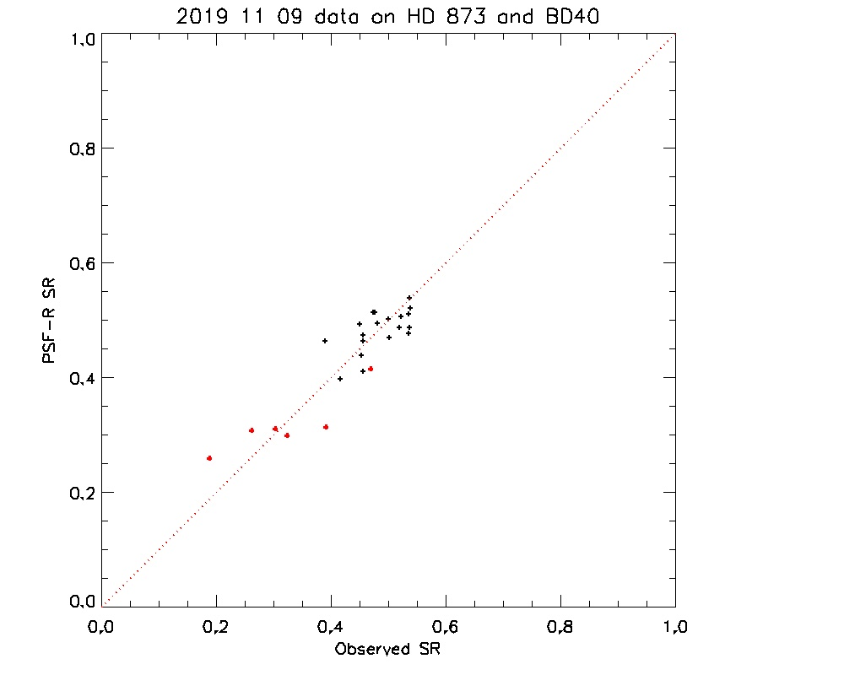
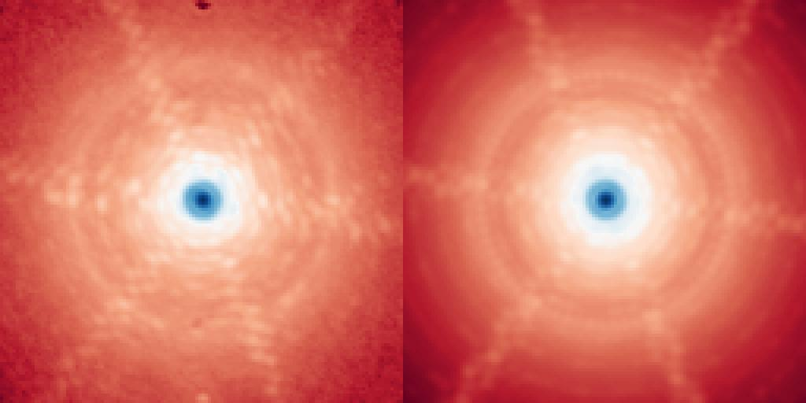
Results
There are no clues for sistematics effect
PSF Observed
PSF Reconstructed
Std dev spread on the 25 points is 0.045 SR points (∼10%)

Slide 32
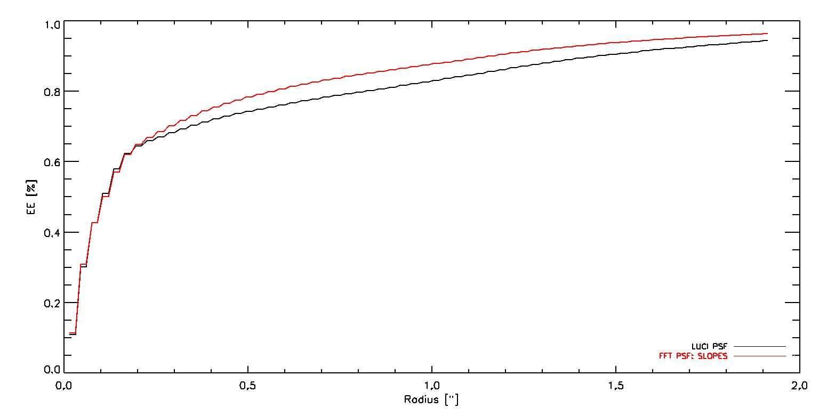
Encircled Energy profile
The Encircled Energy profile is very precise within control radius (< 0.6 arcsec).
On the external region (wings) the background subtraction may play a major role.

Slide 33
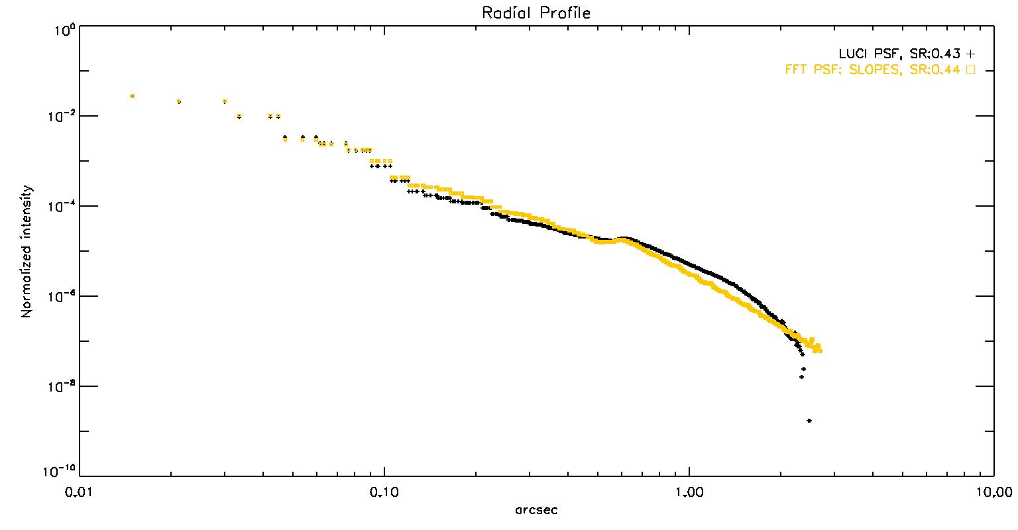
PSF Radial Profile
Control radius peak

Slide 34
Conclusions
We developed a novel algorithm for blind PSF-R.
We tested a solution for the optical gain problem related to the use of pyramid WFS.
The results obtained on the LUCI+SOUL data are very promising, and the PSF-R system can be offered right now as support for the observations (on our server).
Looks promising for MICADO PSF-R
… and that’s all, be safe and take care

